Slide 1

G3T4
By:
Wong En Ting, Kelyn
Lynette Jean Tay
Paul Bryant Madhavan
Chen Wen Han

Slide 2
Table of contents
01
02
03
Problem description
Proposed Application
Front End Tech Stack
04
05
06
Back End Tech Stack
X-Factor
Demo

Slide 3
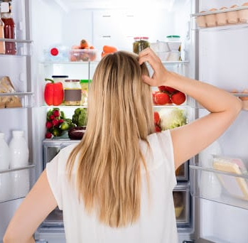
Problem Description
Finding recipes that align with your diet and daily nutrient requirements
Decision paralysis over what to prepare
Difficulty planning meals that not only taste good but also meet your nutritional objectives
Struggling to seamlessly fit buying groceries into weekly routine
Cooking becoming a task instead of a shared experience
Hassle
Time consuming
Tedious
Repetitive
Notes:
Cooking is more than just putting ingredients together.
For anyone that wants to take the next step in their culinary, you would be faced with many obstacles.
Beyond tasting great, do the recipes you find align with your diet and daily nutrient requirements?
Does incorporating grocery shopping into your weekly routine feel like an overwhelming task?
Is cooking losing its charm, slowly turning into just another mundane chore rather than a joyful, shared experience?
If any of these resonate with you, then let me introduce you to our one stop shop recipe discovery and sharing site, Nomsters !

Slide 4
Proposed Application (objectives)
Customizable & Personalizations
Sharing, storing & saving of recipes
Detailed recipe information
Searching for recipes will be accustomed to their diet needs
Meal prep generation
Find grocers near user’s current location
Posting of recipes (enhanced with nutrients info)
Favoriting of recipes
Viewing of own recipes & favorited recipes
Recipe instructions
Ingredients required
Recipe estimated cost
Nutritional facts
Similar recipes
Notes:
Nomsters grants you with the most personalised culinary experience you will ever encounter. With Nomsters, you can find recipes according to your dietary restrictions, generate meal prep plans that are tailored to the number of meals and amount of calories you want to consume each day, and even find grocers near any location that makes it so much easier to incorporate your grocery shopping into your weekly routine.
Your culinary journey is not meant to be walked alone. Nomsters allows users to post recipes which includes enhanced nutrient info, and even allows you to favourite recipes to be looked at another time.
Lastly, nomsters provides detailed recipe information including recipe instructions, ingredients required, recipe estimated cost and nutritional facts, and even recommends similar recipes when viewing a certain recipe.

Slide 5
Proposed Application (features)
Login/
Register
View profile
Customize profile
Browse recipe
View recipe details
Favourite recipe
View favourites
Recipe sharing
View own recipe
Random recipe generator
View near grocers
Generate meal prep
Notes:
Thank you wenhan.
To put all this into perspective, here are all the comprehensive features that Nomsters offers to users which will showcased in the demo later by Kelyn.

Slide 6






Front End Tech Stack
Axios
Notes:
Our project relies on a combination of frontend technologies.
These technologies includes:
HTML which is used for structuring content and defining the web page's foundation.
CSS for styles and control of the layout,
Bootstrap for responsive and mobile-friendly design.
Vue.js which is our frontend framework for building our dynamic website
JavaScript to provide interactivity and manipulates the DOM.
And Axios For making API requests.
These technologies work together to create a user-friendly and visually appealing web application

Slide 7



Back End Tech Stack
Notes:
As for our backend technologies, we used:
Node.js & Express.js to build our robust and scalable APIs to allow the manipulation with the data we have in our database
And we used MariaDB as our database management system used to store and manage our project's data.
Now i will pass the time to paul who will talk more about the APIs we used

Slide 8



APIs Used
Note: [click on the bullet points go to the full list of APIs!]
Spoonacular
Search Recipes
Get Recipe Information
Price Breakdown By ID
Analyze Recipe
Self Created APIs
Login
Sign Up
Get A User
Update User
Delete User
Add or update User Diet
Delete User Diet
Add User Favourite Recipe
Delete User Favourite Recipe
Meal Prep
… and many more!
Google
Google Maps
Google Places
Google Geolocation
Notes:
Our project uses APIs from spoonacular, google and our self created APIs.
The APIs from spoonacular are used to get recipe related data such as nutrition information,cost popularity and many more
APIs from google are utilised in our “find nearby groceries” feature in which we retrieve the user’s current location via the google geolocation service, generate the map through the maps api and lastly provide information about these grocers through the places api.
Our self created APIs mainly serves to provide get, post, update and delete userdata, recipes from our database

Slide 9






X-Factor
DS Cloud
Notes:
In addition to our core technologies, our team has used and implemented "X-factor" tools and services to enhance the application.
These include:
JWT (JSON Web Tokens): Used for secure user authentication and authorization.
GSAP 3 (GreenSock Animation Platform): Used for captivating animations for our web pages, enhancing the user experience.
Animate on scroll: provides animation as the user scrolls through our webpage
DS Cloud: Used as our hosting solution, ensuring the availability of our project to the public
PM2: Used to manage our node.js server, it ensures that the server is kept running and facilitate common system admin tasks.
GitHub: Used as version control and collaboration platform our team, enabling efficient teamwork and code management.

Slide 10

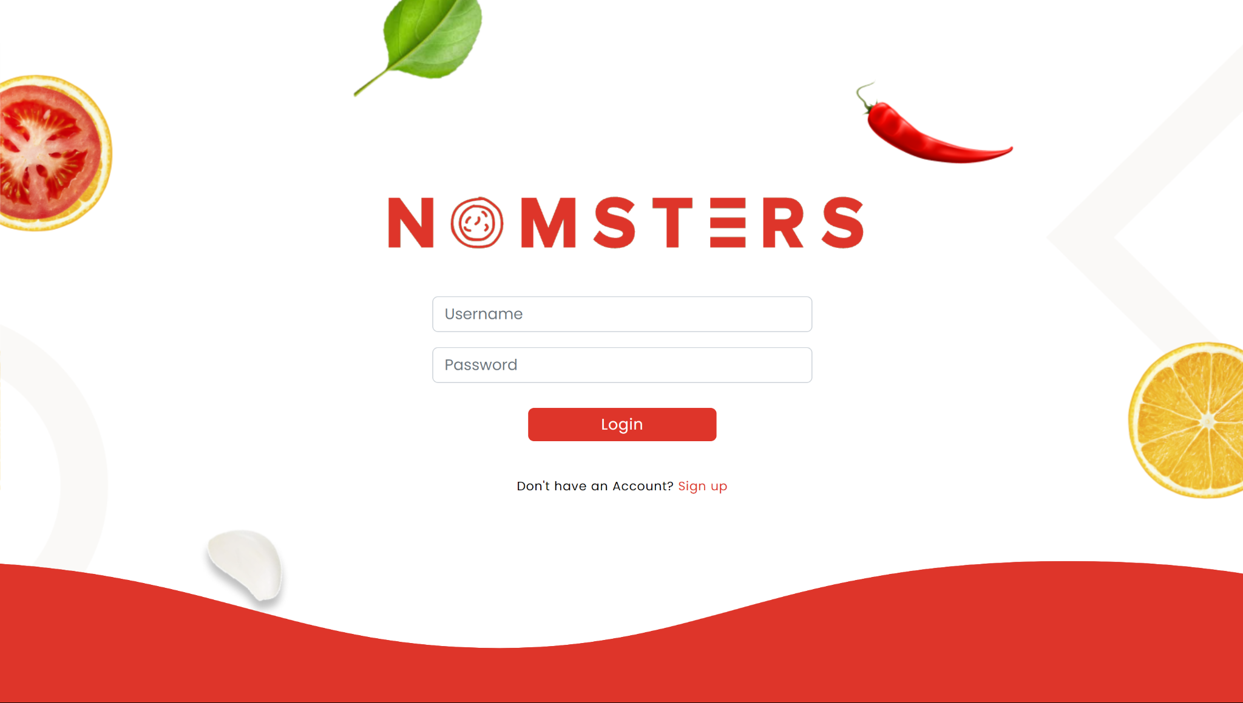
Demo
Notes:
1. show landing page (login page)
When user enters our website, they will be shown the login page.
2. click to go to register page
If a user does not have an existing account, they can click on the sign up button to be redirected to the register page to sign up for an account
3. register for an account (goes to home page) -> [sign up for account without image or diet]
The user is required to enter a username, password
Image and diets are optional
4. scroll and show home page
After user have registered, they will be redirected to the home page which they will be shown some stats on our website, recipes recommended to them, popular cuisines, recipes suited for different times of the day, quick meals under 30mins and caloric balanced recipes
5. go to browse recipe page
When user come to the browse recipe page, they will be shown all recipes or if in the case of when they have set their profile to have certain diets, they will be shown all recipes that suits their diet needs
6. show filter, sort and pagination on the browse recipe page
On this page, the user can filter the recipes by dish type, diet, cuisine, ready in mins, calories, servings and price or they can filter a combination of them
User can also sort by recipe title, popularity or healthiness in either asc or desc
When there is more than 12 recipes, user can view more recipes by pressing the pagination at the bottom
7. go to recipe details page
When the user found a recipe that they are looking for, they can click to view the recipe details which includes required ingredients, instructions, nutrients facts, cost and similar recipes
8. go to nearby grocers page
Users can go to the nearby grocers page when they would like to look for grocers near their current location
9. show regions switching, viewing map markers and more details of grocer
The map will show markers of the location of grocers
If user would like to look at grocers by region, they can also do so
When the user sees a gocer that they would like to visit, they can click to see more details
10. go to submit recipe page
When a user have their own recipe that they would like to publish and share with others, they can do so in this page
11. submit a recipe (goes to profile page)
Submitting a recipe requires the user to enter recipe name, a photo, instructions, ingredients, preparation time, servings, price and categories
12. show posted recipe on profile page
After posting the recipe, user can see their own recipes shared on the profile page
13. edit profile -> [add diet & image]
On this page, the user can edit their profile
They can choose to edit their diet options, username, password or profile image
14. go to browse recipe page to show pre checked box for diet -> [then favourite some recipes]
Since this user has existing diets defined in their profile page, the browse recipe page will only show recipes suited for their diet
15. go to favourites page
Users can always come to this page to view favorited recipes that they have done so in the past
16. delete some favourites
In this page they can also delete the favorited recipes if they no longer like it
17. go to meal prep page
User can generate a meal plan if they would like to prepare food in advance in the event of a hectic day ahead
18. generate meal prep and show details
User can customize the meal prep generation by adjusting the number of meals, snacks, calorie goal and budget on a per day basis
19. search for title of recipe in nav bar
On any page that the user is on, they can search for a recipe title via this search bar in the top navbar
20. generate random recipe
Additionally, if the user cannot decide on what recipe they would like to make, they can use this random recipe generator
21. log out
User can choose to log out when they are done using our website
22. show responsiveness
Our website accommodates to all screen size to create the best user experience
23. log in
To login to our website user has to key in their username and password
24. show responsiveness of home and browse recipe page
The responsiveness extends to our other pages as well

